Slide 1
Cybercrime In The UK
Made By Wisam Siyamak

Slide 2
Outline
Introduction to Cybercrime
Identity Theft
Analysis & Effects
Solutions & Evaluation
Conclusion

Slide 3

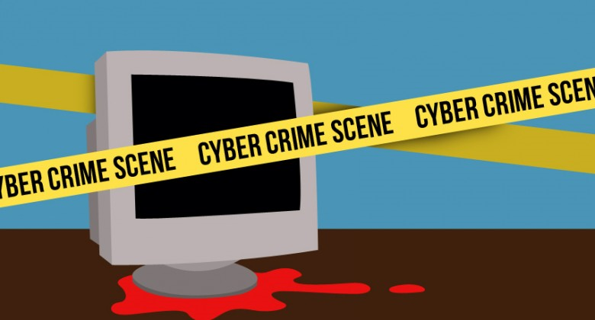
Cybercrime
What is Cybercrime?
(Schell and Martin 2004)
7.6m
(ONS 2015)

Slide 4


Identity Theft
The Problem
The Causes:-
money, opening accounts, cover crimes
31%
(Hoffman and McGinley 2010)
(BBC 2015)
(Atlantic Publishing Group 2008)

Slide 5
Analysis
3.7m
5.1m
(ONS 2015)

Slide 6


The Effects
Unpaid Bills
(Sullivan 2014)
Criminal Record
(ibid)

Slide 7
Solutions
Awareness of The Provided Information
Report Suspicious Activities
(Neate 2013)
(ibid)
Evaluation
2011-2014
Year 2015
Increased to 8%
Decreased to 6%
(ONS 2015)

Slide 8
Conclusion
Identity Theft
Financial
Criminal Record
Awareness – Reporting
Less identity theft incidents

Slide 9
references
Atlantic Publishing Company. 2008. The Online Identity Theft Prevention Kit. Ocala: Atlantic Publishing Group.
BBC NEWS. 2015. Number of identity theft victims 'rises by a third' - BBC News [online]. BBC News. Available at: http://www.bbc.co.uk/news/uk-32890979 [Accessed: 18 Nov. 2015].
Hoffman, S. and McGinley, T. 2010. Identity Theft. Santa Barbara: Greenwood.
Neate, T. 2013. How to prevent identity theft [online]. Available at: http://www.bbc.co.uk/consumer/22342924 [Accessed: 18 Nov. 2015].
Office for National Statistics. 2015. Improving crime statistics in England and Wales – ONS [online]. Available at: http://www.ons.gov.uk/ons/rel/crime-stats/crime-statistics/year-ending-june-2015/sty-fraud.html [Accessed: 20 Nov. 2015].
Office for National Statistics, 2015. Negative Online Experience and Adopted Security Measures. Office for National Statistics.
Schell, B. and Martin, C. 2004. Cybercrime: A Reference Handbook. Santa Barbara: ABC-CLIO.
Sullivan, B. 2014. 9 Surprising Ways Identity Theft Can Hurt You | Credit.com [online]. Available at: http://blog.credit.com/2014/06/surprising-ways-identity-theft-can-hurt-you-85080/ [Accessed: 19 Nov. 2015].

Slide 10

Thank You for Listening
Any Questions ?

